Slide 1
Gestão da mudança e da inovação
7

Slide 2
Objectivos
Comparar e contrastar as várias perspectivas sobre o processo de mudança.
Classificar tipos de mudança organizacional.
Explicar como se gere a resistência à mudança.
Discutir alguns temas atuais sobre a gestão da mudança.
Descrever técnicas para estimular a inovação.

Slide 3
O que é a mudança organizacional?
Mudança organizacional – qualquer alteração nas pessoas, na estrutura ou na tecnologia de uma organização.
Agentes da mudança – pessoas que atuam como catalisadores e assumem a responsabilidade por gerir o processo de mudança.
Notes:
Most managers, at one point or another, will have to change some things in their workplace. We classify these changes as organizational change, which is any alteration of people, structure, or technology.
Organizational changes often need someone to act as a catalyst and assume the responsibility for managing the change process—that is,
a change agent. Change agents can be a manager within the organization, but could be a nonmanager—for example, a change specialist from the HR department or even an outside consultant.

Slide 4
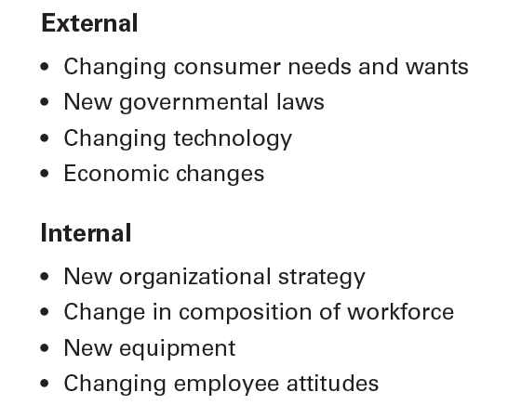
figura 7-1 forças para a mudança –
Externas e Internas
Notes:
Organizations face change because external and internal factors create the need for change (see Exhibit 7-1).

Slide 5
Duas visões sobre o processo de mudança
A metáfora das “águas calmas”
  Processo de mudança calmo e sem problemas. Pode ser ilustrado pelo modelo de Lewin, com três etapas:
    Descongelar(Unfreezing) o status quo.
    Mudar(Changing) para um novo estado.
    Recongelação(Refreezing) tornar a mudança permanente.
Notes:
At one time, the calm waters metaphor was fairly descriptive of the situation managers faced. It’s best discussed using Kurt Lewin’s three-step change process. According to Lewin, successful change can be planned and requires unfreezing the status quo, changing to a new
state, and refreezing to make the change permanent.
Increasingly, managers are realizing that the stability and predictability of the calm waters metaphor don’t exist. Disruptions in the status quo are not occasional and temporary, and they are not followed by a return to calm waters. Instead we have our second change metaphor—white-water rapids. Today, any organization that treats change as the occasional disturbance in an otherwise calm and stable world runs a great risk. Too much is changing too fast for an organization or its managers to be complacent.

Slide 6
Duas visões sobre o processo de mudança
A metáfora das “águas bravas / rápidos”
  A falta de estabilidade e previsibilidade no meio-ambiente requer que gestores e organizações se tenham que adaptar continuamente (gerir a mudança ativamente), para sobreviver.
Notes:
At one time, the calm waters metaphor was fairly descriptive of the situation managers faced. It’s best discussed using Kurt Lewin’s three-step change process. According to Lewin, successful change can be planned and requires unfreezing the status quo, changing to a new
state, and refreezing to make the change permanent.
Increasingly, managers are realizing that the stability and predictability of the calm waters metaphor don’t exist. Disruptions in the status quo are not occasional and temporary, and they are not followed by a return to calm waters. Instead we have our second change metaphor—white-water rapids. Today, any organization that treats change as the occasional disturbance in an otherwise calm and stable world runs a great risk. Too much is changing too fast for an organization or its managers to be complacent.

Slide 7
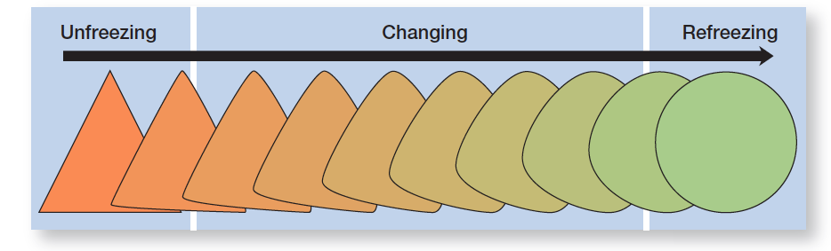
figura 7-2 os três passos do processo de mudança
Notes:
Kurt Lewin’s three-step change process is illustrated by Exhibit 7-2.

Slide 8
Tipos de mudança
Tecnologia
  Adoção de novo equipamento, ferramentas, ou métodos de operar que torna obsoletas as competências existentes e requer novas competências.
  Automação – o trabalho realizado deixa de ser assegurado diretamente por pessoas para ser substituído por máquinas
  Informatização – o uso de computadores/redes para auxiliar as pessoas nas suas funções.
Notes:
Managers face three main types of change: structure, technology, and people. Changes in the external environment or in organizational strategies often lead to changes in the organizational structure. Because an organization’s structure is defined by how work gets done and who does it, managers can alter one or both of these structural components.
Technological changes usually involve the introduction of new equipment, tools, or methods; automation; or computerization. Competitive factors or new innovations within an industry often require managers to introduce new equipment, tools, or operating methods.
Changing people involves changing attitudes, expectations, perceptions, and behaviors— something that’s not easy to do.

Slide 9
Tipos de mudança
Estrutura
  Mudança dos componentes da estrutura ou do desenho organizacional.
Pessoas
  Mudança de atitudes, expectativas, perceções e comportamentos da força de trabalho (RH).
Notes:
Managers face three main types of change: structure, technology, and people. Changes in the external environment or in organizational strategies often lead to changes in the organizational structure. Because an organization’s structure is defined by how work gets done and who does it, managers can alter one or both of these structural components.
Technological changes usually involve the introduction of new equipment, tools, or methods; automation; or computerization. Competitive factors or new innovations within an industry often require managers to introduce new equipment, tools, or operating methods.
Changing people involves changing attitudes, expectations, perceptions, and behaviors— something that’s not easy to do.

Slide 10
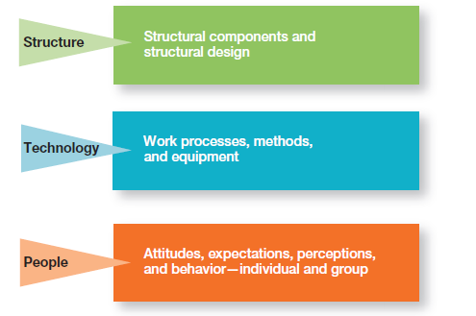
figura 7-3 tipos de mudança
Notes:
Managers face three main types of change: structure, technology, and people as illustrated in Exhibit 7-3.

Slide 11
A mudança nas pessoas
Desenvolvimento Organizacional (DO)
Técnicas ou programas destinados a mudar as pessoas, a natureza e qualidade das relações interpessoais no trabalho.
DO Global
Técnicas de DO que funcionam nos EUA (ou Portugal por exemplo) podem ser pouco apropriadas noutros países e culturas.
Notes:
Changing people involves changing attitudes, expectations, perceptions, and behaviors—something that’s not easy to do. Organizational development (OD) is the term used to describe change methods that focus on people and the nature and quality of interpersonal work relationships.
Managers need to recognize that some techniques that work for U.S. organizations may not be appropriate for organizations or organizational divisions based in other countries.

Slide 12
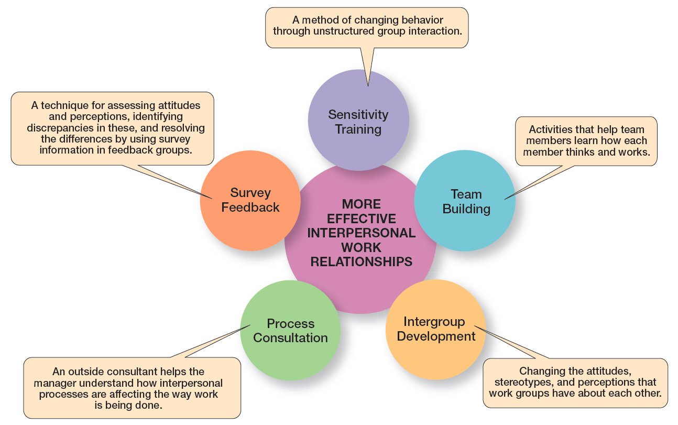
figura 7-4 desenvolvimento organizacional – técnicas populares
Notes:
The most popular OD techniques are described in Exhibit 7-4.

Slide 13
Porque é que as pessoas resistem à Mudança?
Devido à ambiguidade e incerteza que a mudança introduz.
O conforto dos velhos hábitos.
Preocupação com a possível perda de status, dinheiro, autoridade, relações pessoais, ou conveniência pessoal.
Perceção de que a mudança poderá ser incompatível com os objetivos e interesses da organização.
Notes:
Why do people resist change? The main reasons include uncertainty, habit, concern over personal loss, and the belief that the change is not in the organization’s best interest. Change replaces the known with uncertainty. Another cause of resistance is that we do things out of habit. The third cause of resistance is the fear of losing something already possessed. Change threatens the investment you’ve already made in the status quo. A final cause of resistance is a person’s belief that the change is incompatible with the goals and interests of the organization.

Slide 14
Técnicas para reduzir a resistência à Mudança
Educação e Comunicação
Participação
Facilitação e apoio
Negociação
Manipulação
Coerção
Notes:
Several strategies have been suggested in dealing with resistance to change. These approaches include education and communication, participation, facilitation and support, negotiation, manipulation and co-optation, and coercion.
Education and communication can help reduce resistance to change by helping employees see the logic of the change effort. This technique, of course, assumes that much of the resistance lies in misinformation or poor communication.
Participation involves bringing those individuals directly affected by the proposed change into the decision-making process. Their participation allows these individuals to express their feelings, increase the quality of the process, and increase employee commitment to the final decision.
Facilitation and support involve helping employees deal with the fear and anxiety associated with the change effort. This help may include employee counseling, therapy, new skills training, or a short paid leave of absence.
Negotiation involves exchanging something of value for an agreement to lessen the resistance to the change effort. This resistance technique may be quite useful when the resistance comes from a powerful source.
Manipulation and co-optation refer to covert attempts to influence others about the change. It may involve distorting facts to make the change appear more attractive.
Finally, coercion can be used to deal with resistance to change. Coercion involves the use of direct threats or force against the resisters.

Slide 15
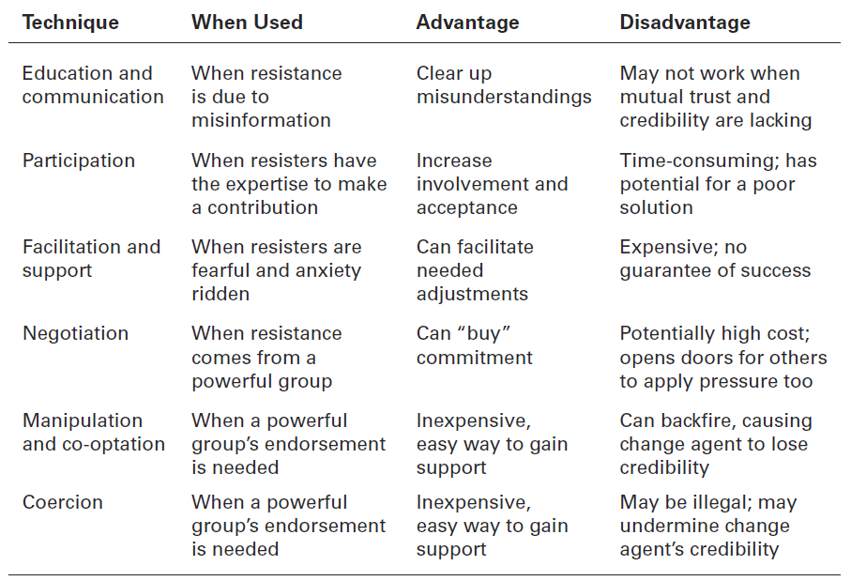
figura 7-5
Técnicas para reduzir a resistência à mudança
Notes:
When managers see resistance to change as dysfunctional, what can they do? Several strategies have been suggested in dealing with resistance to change. These approaches include education and communication, participation, facilitation and support, negotiation,
manipulation and co-optation, and coercion. These tactics are summarized and described in Exhibit 7-5.

Slide 16
Mudança da Cultura Organizacional
As culturas são naturalmente resistentes à mudança.
Condições facilitadoras da mudança cultural:
  Ocorrência de uma crise importante.
  Mudança de liderança.
  A organização é jovem, flexível e pequena.
  Uma fraca cultura organizacional.
Notes:
An organization’s culture, made up of relatively stable and permanent characteristics, tends to make it very resistant to change. A culture takes a long time to form, and once established, it tends to become entrenched. Strong cultures are particularly resistant to change because employees have become so committed to them.

Slide 17
Compreender os fatores situacionais
Crise importante – Um inesperado problema financeiro, a perda de um cliente importante, uma importante inovação tecnológica por parte de um concorrente.
Mudança de liderança – Uma nova liderança (e.g. nova administração) pode trazer um novo conjunto de valores para a organização.
Organização nova, flexível e pequena.
Cultura fraca.
Notes:
What “favorable conditions” facilitate cultural change? One is that a dramatic crisis occurs, such as an unexpected financial setback, the loss of a major customer, or a dramatic technological innovation by a competitor. Such a shock can weaken the status quo and make people start thinking about the relevance of the current culture. Another condition may be that leadership changes hands. New top leadership can provide an alternative set of key values and may be perceived as more capable of responding to the crisis than the old leaders were. Another is that the organization is young and small. The younger the organization, the less entrenched its culture.

Slide 18
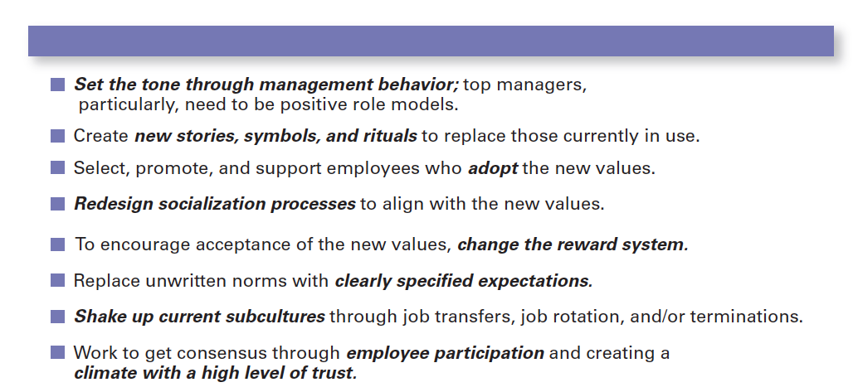
figura 7-6 mudança cultural
Notes:
If conditions are right, how do managers change culture? No single action is likely to have the impact necessary to change something ingrained and highly valued. Managers need a strategy for managing cultural change, as described in Exhibit 7-6.

Slide 19
Stress dos empregados
Stress – A reação adversa que as pessoas têm decorrente de um excesso de pressão exercida sobre as mesmas, resultante de solicitações extraordinárias, condicionantes ou oportunidades.
Stressors – Fatores que causam stress.
Notes:
Stress is the adverse reaction people have to excessive pressure placed on them from extraordinary demands, constraints, or opportunities. Stress isn’t always bad. Although it’s often discussed in a negative context, stress can be positive, especially when it offers a potential gain. For instance, functional stress allows an athlete, stage performer, or employee to perform at his or her highest level at crucial times.
Stress can be caused by personal factors and by job-related factors called stressors. Clearly, change of any kind—personal or job-related—has the potential to cause stress because it can involve demands, constraints, or opportunities. Organizations have no shortage of factors that can cause stress.

Slide 20
O que causa o Stress?
Conflito de papeis – Expectativas de trabalho diversas e que são difíceis de satisfazer e/ou conciliar.
Sobrecarga de trabalho – a quantidade de trabalho solicitada é superior ao que seria equilibrado, para o tempo disponível.
Ambiguidade de papeis – quando as expectativas sobre o trabalho não são claras e o trabalhador não está certo sobre o que tem que fazer, ou como deve fazê-lo.
Notes:
Role demands relate to pressures placed on an employee as a function of the particular role he or she plays in the organization. Role conflicts create expectations that may be hard to reconcile or satisfy. Role overload is experienced when the employee is expected to do more than time permits. Role ambiguity is created when role expectations are not clearly understood and the employee is not sure what he or she is to do.

Slide 21
O que causa o Stress?
(cont.)
Solicitações Interpessoais – Pressão exercida por outras pessoas (e.g. colegas, chefes, clientes, etc.).
Estrutura Organizacional – excesso/deficit de regras, falta de oportunidade para participar nas decisões.
Liderança organizacional – O estilo de liderança/supervisão dos gestores da organização.
Notes:
Interpersonal demands are pressures created by other employees. Lack of social support from colleagues and poor interpersonal relationships can cause considerable stress, especially among employees with a high social need.
Organization structure can increase stress. Excessive rules and an employee’s lack of opportunity to participate in decisions that affect him or her are examples of structural variables that might be potential sources of stress.
Organizational leadership represents the supervisory style of the organization’s managers. Some managers create a culture characterized by tension, fear, and anxiety. They establish unrealistic pressures to perform in the short run, impose excessively tight controls, and routinely fire employees who don’t measure up. This style of leadership filters down through the organization and affects all employees.

Slide 22
fatores pessoais que podem gerar stress
Personalidade Tipo A – pessoas com um sentido de urgência crónico e uma competitividade extrema.
Personalidade Tipo B – pessoas calmas, acessíveis e que aceitam a mudança de forma fácil.
Notes:
Personal factors that can create stress include family issues, personal economic problems, and inherent personality characteristics. Because employees bring their personal problems to work with them, a full understanding of employee stress requires a manager to be understanding of these personal factors.
Type A personality is characterized by chronic feelings of a sense of time urgency, an excessive competitive drive, and difficulty accepting and enjoying leisure time. The opposite of Type A is Type B personality. Type Bs don’t suffer from time urgency or impatience. Until recently, it was believed that Type As were more likely to experience stress on and off the job. A closer analysis of the evidence, however, has produced new conclusions. Studies show that only the hostility and anger associated with Type A behavior are actually associated with the negative effects of stress. And Type Bs are just as susceptible to the same anxiety-producing elements.

Slide 23
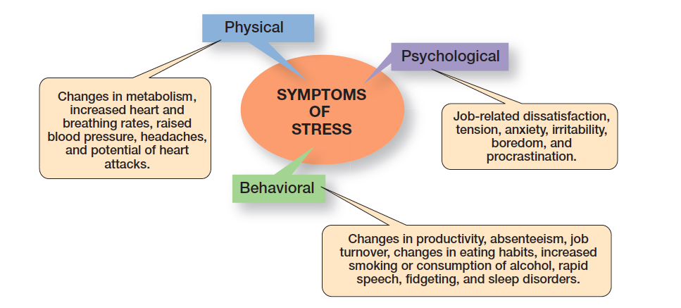
figura 7-7
SiNtomas de Stress
Notes:
As Exhibit 7-7 shows, stress symptoms can be grouped under three general categories: physical, psychological, and behavioral. All of these can significantly affect an employee’s work.

Slide 24
Como se pode reduzir o stress?
Os fatores relacionados com o trabalho começam com a seleção dos empregados.
Uma entrevista de emprego realista/honesta pode minimizar a probabilidade de ocorrência de stress, reduzindo a ambiguidade e promovendo o alinhamento das expectativas em relação ao trabalho.
Um plano de desempenho, como o MBO (gestão por objetivos), irá ajudar a clarificar as responsabilidades do trabalho, os objetivos, reduzindo assim a ambiguidade.
Notes:
Because stress can never be totally eliminated from a person’s life, managers want to reduce the stress that leads to dysfunctional work behavior. How? Through controlling certain organizational factors to reduce job-related stress, and to a more limited extent, offering help for personal stress.
Things managers can do in terms of job-related factors begin with employee selection. Managers need to make sure an employee’s abilities match the job requirements. When employees are in over their heads, their stress levels are typically high. A realistic job preview during the selection process can minimize stress by reducing ambiguity over job expectations. Improved organizational communications will keep ambiguity-induced stress to a minimum. Similarly, a performance planning program such as MBO (management by objectives) will clarify job responsibilities, provide clear performance goals, and reduce ambiguity through feedback. Job redesign is also a way to reduce stress. If stress can be traced to boredom or to work overload, jobs should be redesigned to increase challenge or to reduce the workload.

Slide 25
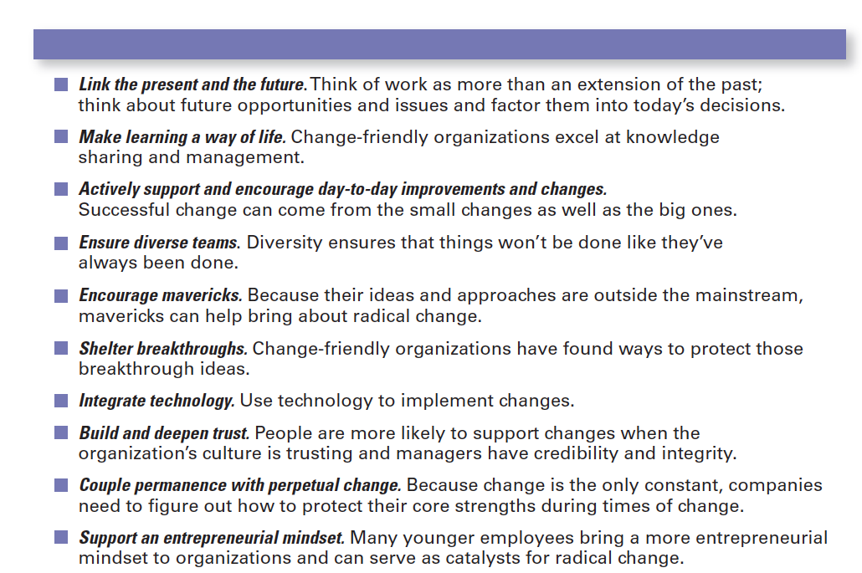
figura 7-8
Organizações capazes de mudar
Notes:
What does it take to be a change-capable organization? Exhibit 7-8 summarizes the characteristics.

Slide 26
Estimular a inovação
Criatividade – a capacidade de combinar ideias de uma forma única.
Inovação – transformar os resultados do processo criativo em produtos, serviços ou processos úteis.
Notes:
The definition of innovation varies widely, depending on who you ask. We’re going to define it by first looking at the concept of creativity. Creativity refers to the ability to combine ideas in a unique way or to make unusual associations between ideas.
The outcomes of the creative process need to be turned into useful products or work methods, which is defined as innovation. Thus, the innovative organization is characterized by its ability to generate new ideas that are implemented into new products, processes, and procedures designed to be useful—that is, to channel creativity into useful outcomes.

Slide 27
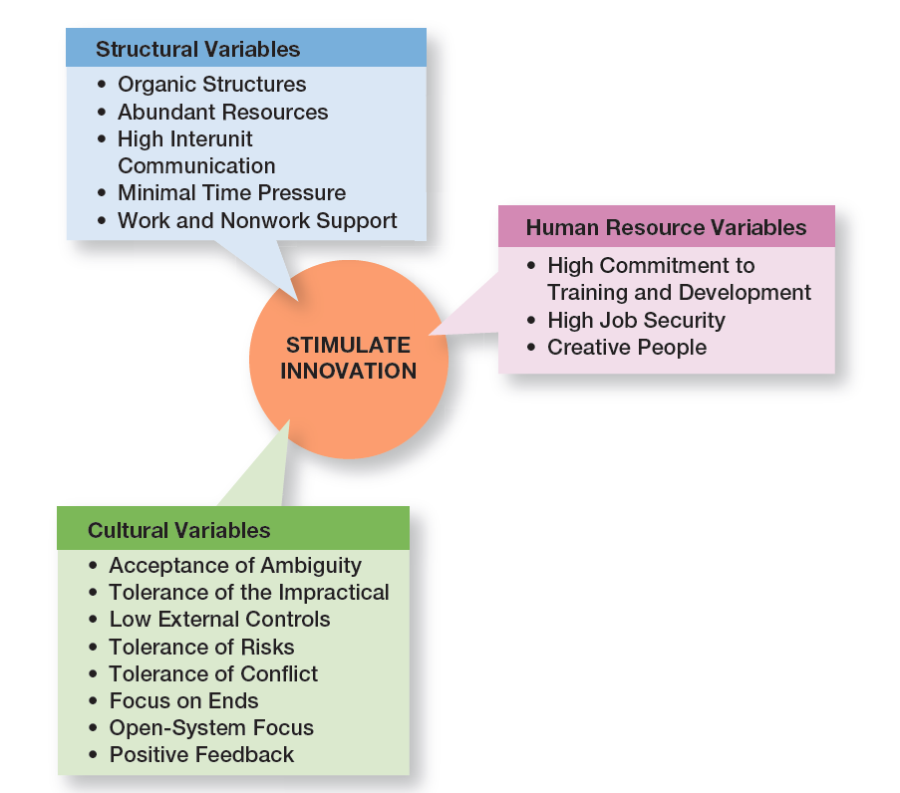
figura 7-9 variáveis que estimulam a inovação
Notes:
Having creative people isn’t enough. It takes the right environment to help transform those inputs into innovative products or work methods. This “right” environment—that is, an environment that stimulates innovation—includes three variables: the organization’s structure, culture, and human resource practices as illustrated in Exhibit 7-9.

Slide 28
Variáveis estruturais
Uma estrutura de tipo orgânico influencia positivamente a inovação.
A disponibilidade de uma grande diversidade de recursos é uma base importante para a inovação.
A frequente comunicação entre unidades da organização ajuda a ultrapassar as barreiras criadas pela sua estrutura.
Notes:
An organization’s structure can have a huge impact on innovativeness. An organic-type structure positively influences innovation. Because this structure is low in formalization, centralization, and work specialization, it facilitates the flexibility and sharing of ideas that are critical to innovation.
The availability of plentiful resources provides a key building block for innovation. With an abundance of resources, managers can afford to purchase innovations, can afford the cost of instituting innovations, and can absorb failures. For example, at Smart Balance Inc., the heart-healthy food developer uses its resources efficiently by focusing on product development and outsourcing almost everything else, including manufacturing, product distribution, and sales. The company’s CEO says this approach allows them to be “a pretty aggressive innovator” even during economic downturns. Additionally, frequent communication between organizational units helps break down barriers to innovation.

Slide 29
Variáveis estruturais (cont.)
Organizações inovadoras tentam minimizar as pressões exageradas de tempo sobre as atividades criativas.
Estudos demonstram que o desempenho criativo dos empregados é aumentado quando a estrutura da organização apoia, explicitamente, a criatividade.
Notes:
Innovative organizations try to minimize extreme time pressures on creative activities despite the demands of whitewater rapids environments. Although time pressures may spur people to work harder and may make them feel more creative, studies show that it actually causes them to be less creative.
Finally, studies have shown that an employee’s creative performance was enhanced when an organization’s structure explicitly supported creativity. Beneficial kinds of support included things like encouragement, open communication, readiness to listen, and useful feedback.

Slide 30
Variáveis culturais
Aceitação da ambiguidade – Demasiado ênfase na objetividade e definição de âmbito, limitado à partida, condicionam a criatividade.
Tolerância pelo impraticável – O que à partida pode ser ou parecer impraticável, pode levar a soluções inovadoras.
Manter controlos externos no mínimo - regras, regulamentos, políticas e outros controlos organizacionais devem ser mantidos no seu mínimo.
Notes:
Innovative organizations tend to have similar cultures. They encourage experimentation, set creativity goals, reward both successes and failures, and celebrate mistakes. An innovative organization is likely to have the following characteristics.
Accept ambiguity. Too much emphasis on objectivity, and specificity constrains creativity.
Tolerate the impractical. Individuals who offer impractical, even foolish, answers to what-if questions are not stifled. What at first seems impractical might lead to innovative solutions. Encourage entrepreneurial thinking.
Keep external controls minimal. Rules, regulations, policies, and similar organizational controls are kept to a minimum.

Slide 31
Variáveis culturais (cont.)
Tolerar o risco – Empregados são encorajados a experimentar, sem medo de sofrer consequências por um eventual insucesso.
Tolerar o conflito – A diversidade de opiniões é encorajada.
Focalização nos fins e não nos meios – os indivíduos são encorajados a considerarem novas formas para atingir os objetivos.
Notes:
Tolerate risk. Employees are encouraged to experiment without fear of consequences should they fail. “Failure, and how companies deal with failure, is a very big part of innovation.” Treat mistakes as learning opportunities.
Tolerate conflict. Diversity of opinions is encouraged. Harmony and agreement between individuals or units are not assumed to be evidence of high performance.
Focus on ends rather than means. Goals are made clear, and individuals are encouraged to consider alternative routes toward meeting the goals. Focusing on ends suggests that several right answers might be possible for any given problem.

Slide 32
Variáveis culturais (cont.)
Usar uma perspetiva de sistema aberto – os gestores monitorizam de forma atenta o ambiente externo, respondendo atempadamente às mudanças.
Feedback positivo – gestores fornecem feedback positivo, encorajando e dando apoio.
Liderar dando poder (empowering) – Os lideres prescindem de algum do seu poder em favor de trabalhadores que participam mais nas decisões e que, assim, se sentem a realizar um trabalho de maior significado.
Notes:
Use an open-system focus. Managers closely monitor the environment and respond to changes as they occur. For example, at Starbucks, product development depends on “inspiration field trips to view customers and trends.”
Provide positive feedback. Managers provide positive feedback, encouragement, and support so employees feel that their creative ideas receive attention.
Exhibit empowering leadership. Be a leader who lets organizational members know that the work they do is significant. Provide organizational members the opportunity to participate in decision-making. Show them you’re confident they can achieve high performance levels and outcomes. Being this type of leader will have a positive influence on creativity.

Slide 33
Variáveis de Recursos humanos
Patrocinador de Ideias (idea champion)
Indivíduos que apoiam ativa e entusiasticamente as novas ideias, criando apoios, ultrapassando resistências e certificando-se que as inovações são implementadas.
Notes:
Innovative organizations actively promote the training and development of their members so their knowledge remains current; offer their employees high job security to reduce the fear of getting fired for making mistakes; and encourage individuals to become idea champions, actively and enthusiastically supporting new ideas, building support, overcoming resistance, and ensuring that innovations are implemented.

Slide 34
Inovação e Design Thinking
Existe uma forte ligação entre o design thinking e a inovação.
Com uma perspectiva de design thinking, a ênfase está em ganhar um maior e mais profundo conhecimento do que são as necessidades e preferências dos clientes.
Notes:
A strong connection exists between design thinking and innovation. “Design thinking can do for innovation what TQM did for quality.” Just as TQM provides a process for improving quality throughout an organization, design thinking can provide a process for coming up with things that don’t exist. When a business approaches innovation with a design thinking mentality, the emphasis is on getting a deeper understanding of what customers need and want.

Slide 35


